Slide 1
Mini project Presentation on
Smart Traffic Management According to Vehicle Density and Adaptive Street Light Control
Sr No | Name of Student | Seat Number
1 | Prathamesh Prakash Adivarekar
2
3
Under the Guidance
of

Slide 2
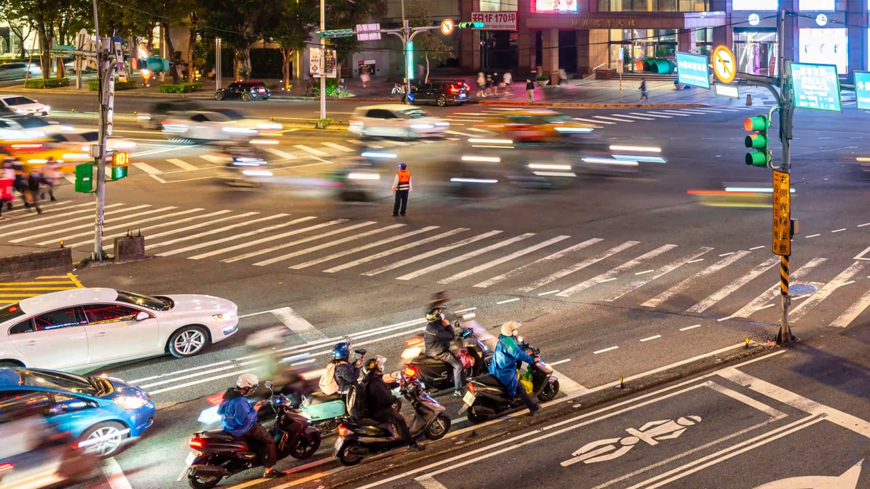


Slide 3
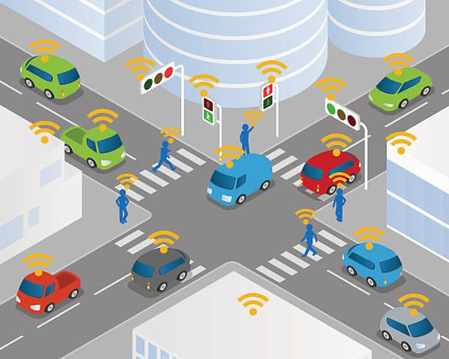
Introduction
Smart Traffic Management According to Vehicle Density and Adaptive Street Light Control
This project presents an intelligent traffic control system that dynamically adjusts traffic signals based on real-time vehicle density.
It also includes an adaptive street lighting system that controls brightness according to ambient light conditions.
The system aims to reduce traffic congestion, improve road safety, and minimize energy consumption.
It is designed using a microcontroller-based approach for efficient and low-cost implementation.

Slide 4
Aim & Objectives
Aim
To design and develop an automated traffic management system that optimizes traffic signal timing based on vehicle density and controls street lighting adaptively for energy efficiency.
Objectives
To detect vehicle density on each road using sensors.
To dynamically control traffic signal timing based on real-time data.
To implement adaptive street lighting using ambient light sensing.
To reduce waiting time at intersections and avoid unnecessary delays.
To minimize power consumption by controlling street light intensity.
To design and simulate the system before hardware implementation.

Slide 5
Specifications
Power Supply: The system operates on a regulated 5V DC power supply suitable for microcontroller
and sensors.
Microcontroller: Arduino Uno (ATmega328P) is used as the main controller for processing inputs and
controlling outputs.
Vehicle Detection: Ultrasonic sensors are used to detect the presence of vehicles in each lane.
Traffic Signal Control: LEDs are used to represent Red, Yellow, and Green traffic lights.
Street Light Control: LED street lights are controlled using PWM (Pulse Width Modulation)
for brightness adjustment.
Ambient Light Detection: LDR (Light Dependent Resistor) is used to sense surrounding light conditions.

Slide 6
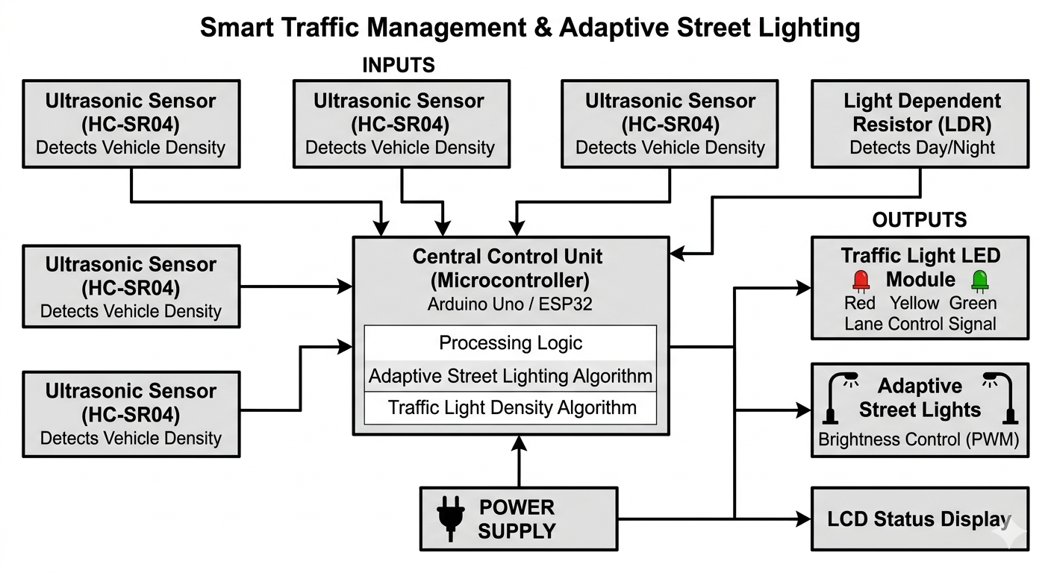
Block Diagram

Slide 7
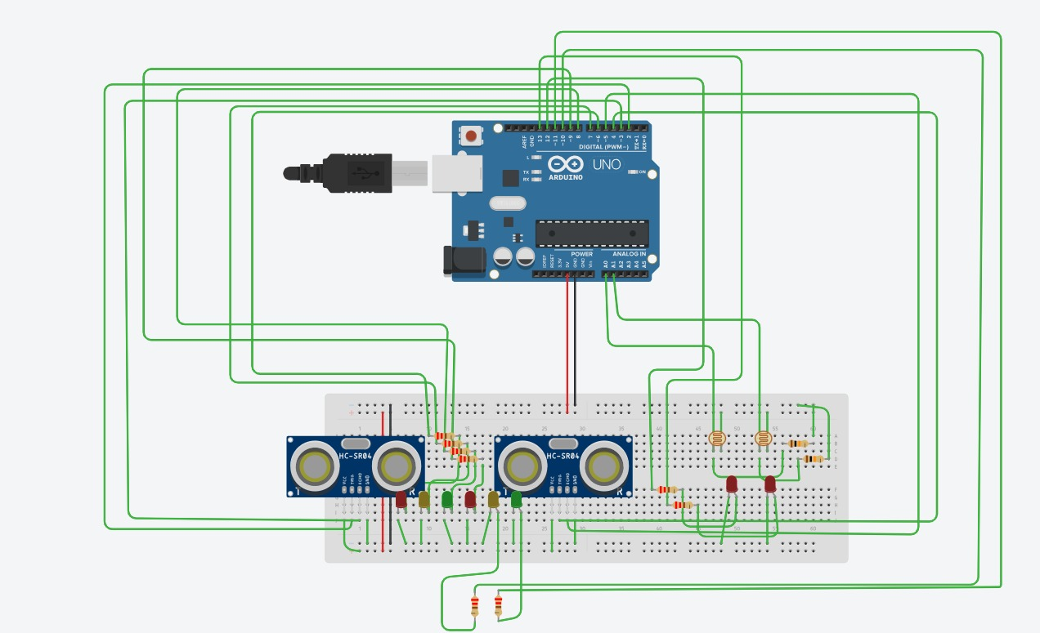
Simulation

Slide 8
Ultrasonic sensors successfully detected vehicle presence in different lanes.
Traffic signals changed dynamically based on vehicle density.
The waiting time at signals was reduced compared to fixed-timer systems.
Street lights adjusted brightness according to ambient light conditions.
The simulation demonstrated smooth traffic flow and efficient energy usage.
The system showed reliable and stable performance during testing.

Slide 9
Selection of Components & Calculations
Component Selection :
Ultrasonic Sensors: Chosen for reliable and fast detection of vehicles.
Arduino Uno: Selected due to ease of programming and sufficient I/O pins.
LDR: Used for simple and cost-effective light sensing.
LEDs: Used to simulate traffic lights and street lights.
Resistors: Used to limit current and protect components.
Traffic Density Logic:
If vehicle count is high → increase green signal time.
If vehicle count is low → reduce green signal time.

Slide 10
Conclusion
The project successfully demonstrates a smart traffic management system based on vehicle density.
It effectively reduces congestion and improves traffic flow.
The adaptive street lighting system contributes to significant energy savings.
The system is scalable and can be implemented in real-world smart city applications.

Slide 11
References:
S. Sharma, A. Gupta, and R. Mehta, “Smart Traffic Management System Using IoT and Machine Learning,” IEEE Access, vol. 11, pp. 24567–24578, 2023.
J. Patel and M. Shah, “Adaptive Traffic Signal Control System Based on Vehicle Density,” International Journal of Advanced Research in Electrical Engineering, vol. 10, no. 3, pp. 112–118, 2022.
R. K. Singh and P. Verma, “Intelligent Street Lighting System Using LDR and Arduino,” IEEE Sensors Journal, vol. 21, no. 5, pp. 5678–5685, 2021.

Slide 12
Thank You

